Slide 1


Bapuji Institute of Engineering and Technology Davangere-577004
DEPARTMENT OF COMPUTER SCIENCE AND ENGINEERING
Technical Seminar– 2024
on
“DEMONSTRATION OF HAPTIC TECHNOLOGY, A HANDS-ON APPROACH TO VIRTUAL REALITY”
SEMINAR GUIDES:
Dr. Arun kumar G Hiremath
Assoc. Prof. CS&E Dept.
Prof. Priya V
Asst. Prof. CS&E Dept.
HEAD OF DEPARTMENT:
Dr. Nirmala C R
Prof. & Head,
Dept. of CS&E
SEMINAR COORDINATORS:
Prof. Rahima B
Prof. Madhu N Hiremath
Presented By:
Syed Farhan
4BD20CS104

Slide 2
INTRODUCTION
The term ‘haptic’ gained a new meaning in the early 1990s. It originates from the Greek word ‘haptesthai’, which means ‘to touch’.
Scientists use ‘haptics’ to refer to the study of touch-based perception and manipulation.
Haptics is a rapidly growing area within technology. It is applied across various fields such as education, medicine, defense, neurology, and computer science.
Haptic technology allows users to feel and manipulate 3D objects. Users can discern factors like shape, weight, surface textures, and temperature.
Haptic sensations are linked to sensory nerves in the brain, connected through muscles and joints.
These devices can measure the force exerted by a user on an interface. They enhance the interaction with visuals, allowing users to feel the impact of their actions.

Slide 3
WORKING OF HAPTIC DEVICES
The system includes capacitive touch sensor devices, a processor, a driver circuit, actuators, a real-time algorithm, a library of haptic effects, and an API.
Input is provided through touch or press on capacitive buttons.
Sensors detect force and angle variations, relaying this data to the CPU.
The CPU processes the data to create a waveform.
This waveform, digital or analog, instructs the actuator.
Actuators create a vibration pattern, producing force feedback.
Users experience this feedback virtually through touch screen devices.

Slide 4
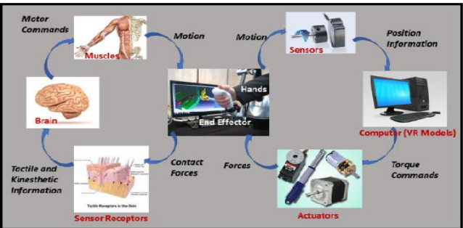
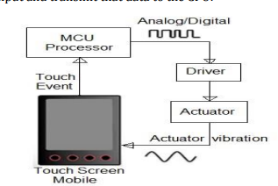
Fig. Haptic Feedback on Mobile Touch
Fig. Comparison of Human and Computer Haptic Feedbacks

Slide 5
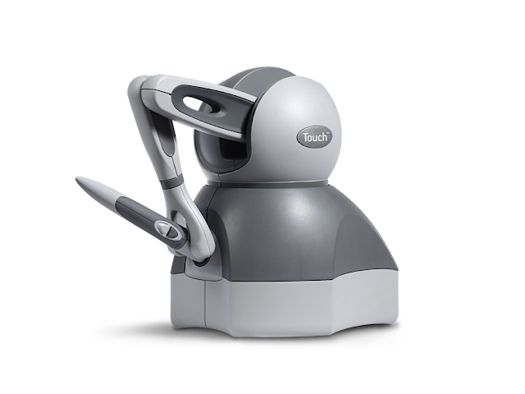
COMMONLY USED HAPTIC DEVICES
PHANTOM:
Phantom haptic devices are devices that provide force feedback and a range of motion.
They are designed to allow the user to interact with the computer by inserting their finger into a thimble
Just as the monitor enables users to see computer generated images, and audio speakers allow them to hear synthesized sounds, the PHANTOM device makes it possible for users to touch and manipulate virtual objects.

Slide 6
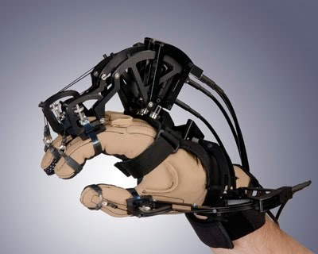
2. Cyber Grasp:
The Cyber Grasp system is an innovative force feedback system for your fingers and hand. It lets you "reach into your computer" and grasp computer-generated or tele-manipulated objects.
he device exerts grasp forces that are roughly perpendicular to the fingertips throughout the range of motion, and forces can be specified individually.
Cyber Grasp system allows full range-of-motion of the hand and does not obstruct the wearer's movements. The device is fully adjustable and designed to fit a wide variety of hands

Slide 7
LIMITATIONS
Obtaining millimeter accuracy is difficult or impossible. The accuracy is intrinsically limited by the 8.5- millimeter wavelength associated with 40 kHz ultrasound.
Large arrays make the gadget larger, more expensive, and heavier.
Limited Workspace: One significant issue is the limited workspace of haptic systems, particularly in desktop interfaces. This can restrict the range of movements and gestures that a user can perform.
Technical Drawbacks: There can be issues with sensors and actuators, as well as compatibility and connectivity issues. Communication between haptic devices can also be problematic, as different types of haptic systems may use different communication protocols or standards.

Slide 8
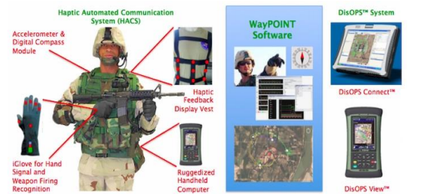
APPLICATIONS OF HAPTIC TECHNOLOGY
Military
It is used to provide flexibility in the military field, which includes training in a virtual reality environment. Additionally, it uses a graspable haptic technology for bomb disposal.

Slide 9
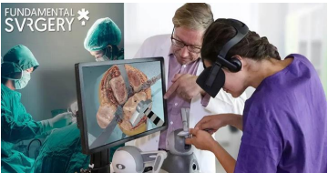
2. Medical
Haptic interfaces are used in medical applications such as remote surgery and virtual training for healthcare professionals.

Slide 10
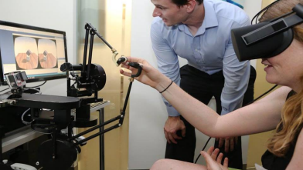
3. Education
It is frequently used to grasp concepts in educational fields such as chemistry, arithmetic, physics, and engineering, as well as in medical training. They employ virtual reality environments mostly.

Slide 11
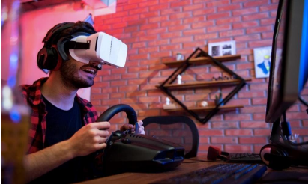
4. Gaming
This technology is used in video games by the gaming industry.

Slide 12
ADVANTAGES AND DISADVANTAGES
Haptic technology has the following advantages :
High levels of accuracy and precision.
Ease of access and ease of operation.
Anyone can experience and perceive a digital environment.
Haptic technology has the following disadvantage :
There are significant upfront investment costs.

Slide 13
CONCLUSION
Finally, we conclude that haptic technology, which is frequently applied in many applications, is the best method for engaging with a virtual environment. Haptic devices serve as input and output devices, sensing user physical input manipulation and producing a realistic touch output in time with the onscreen event. as technology advances and becomes more practical. technology that can be felt and manipulated. The haptic devices need to be simpler and easier to operate, and this technology needs to be made accessible for a reasonable price.

Slide 14
Thank You

